Slide 1
Special Immigrant Juvenile Status
Sin Yen Ling, Immigration Project Director
Emma Morgenstern, Immigrant Justice Corps Fellow
JANUARY 2022

Slide 2
VOLS: Who We Are
Volunteers of Legal Service harnesses the power of New York City’s legal community and neighborhood-based partners to provide free, civil legal services when and where they are needed most. Our staff and volunteer lawyers help New Yorkers to attain dignity, security, and opportunity.
EQUAL JUSTICE
We serve New Yorkers who are unable to access legal support due to low household income or underserved socio-economic background.
EXPERT SERVICE
Our public-interest staff attorneys work alongside 1,000+ pro bono lawyers to advise, represent, and advocate on behalf of our clients.
COMMUNITY IMPACT
We partner with 200+ local organizations, such as schools or community nonprofits, to help anchor the safety net in New York City.

Slide 3
Today’s Objectives
Learn basics of immigration options for children
Understand New York State Family Court procedures
Discuss Petitioning for Special Immigrant Juvenile Status (SIJS)
Cover policy changes & federal litigation updates

Slide 4
What are the benefits of SIJS?
SIJS grantees can apply for a “green card,” which lets someone live and work anywhere in the United States, permanently!
Provides stability and health insurance in a familial relationship
Is a pathway to U.S. Citizenship
SIJS waives many grounds of inadmissibility
Stability
U.S. Identity Documents
Housing
Health Insurance
Financial Aid
Employment

Slide 5
Immigration Basics

Slide 6
General Immigration Categories
US Citizen
Lawful Permanent Resident (aka green card holder)
Humanitarian Categories (such as TPS, Asylee)
Non-immigrant Status (temporary visas)
No immigration status or undocumented (including people who never had status, or those who had it and lost it)

Slide 7
Pathways to Permanent Residence
Sponsorship by certain, qualifying family members
Sponsorship by employers
Humanitarian Categories:
Asylees & refugees, survivors of crimes, DV & trafficking, SIJS
Diversity Lottery

Slide 8
Qualifying for SIJS

Slide 9
What is SIJS?
Humanitarian pathway to lawful permanent residence
Under Federal law, SIJS is available to children who:
Are under 21 years old
Are unmarried
Are dependent on a state family or juvenile court
Cannot be reunified with one or both parents due to abandonment, abuse, neglect or a similar basis under state law
Should remain in the U.S. because it is not in their best interest to be returned to their country of birth
8 U.S.C. 1101(a)(27)(j); INA 101(a)(27)(j); 8 C.F.R 204.11

Slide 10
What is SIJS?
Family Court
Family Court makes factual findings & issues a “SIJS Predicate Order”
SIJS Petition
SIJS Predicate Order allows a child to petition USCIS for SIJS
Green Card
SIJS petitioners can seek permanent residence
SIJS grantees can never petition for either parent, even after becoming a US Citizen

Slide 11
Who is “under 21” and “unmarried”?
Under 21
Prove with birth certificate, passport, or government ID
SIJS Petition must be received by USCIS while child is under 21
Unmarried
Prove with affidavit
Child needs to remain unmarried through adjudication
Polygamous, cultural, or underage marriages may not count as marriages
Okay if she turns 21 before adjudication

Slide 12
What does it mean to be “dependent” on a juvenile court?
Under federal law:
“who has been declared dependent on a juvenile court …”
As applied in NY Family Court:
Guardianship
“or whom such a court has legally committed to, or placed under the custody of, an agency or department of a State, or an individual or entity appointed by a State or juvenile court….”
Custody
Abuse & Neglect proceedings
Family Offenses
Destitute Child
Persons in Need of Supervision (PINS)
Delinquency (recent negative 2d Dept case)

Slide 13
With whom is reunification “not viable”?
Under federal law:
“whose reunification with one or both of the immigrant’s parents is not viable…”
As applied in NY Family Court:
Children of single parents may be SIJS eligible
“[T]he ‘1 or both’ language requires only a finding that reunification is not viable with 1 parent.” Matter of Marcelina M.G., 973 N.Y.S.2d 714 (2d Dep’t 2013).

Slide 14
Abuse, Neglect, Abandonment or a Similar Basis Under State Law
Under federal law:
“…due to abuse, neglect, abandonment, or a similar basis found under State law”
As applied in NY Family Court:
No emotional or financial support
No meaningful communication
Physical or psychological abuse
Death or inability of parent to care for child

Slide 15
Why wouldn’t it be “in the best interest” of a child to return to her country of nationality?
Under federal law:
As applied in NY Family Court:
Child’s safety and stability are paramount
Totality of the circumstances:
Emotional, educational, medical & social needs
Wishes of the child
Quality of home environment
“for whom it has been determined… that it would not be in the alien’s best interest to be returned to the alien’s or parent’s previous country of nationality or country of last habitual residence”

Slide 16
Applying for SIJS
Step 1: Family Court

Slide 17
Who is your client?
Determine who you are representing before filing in Family Court
This training assumes representation of the child
NYS Family Courts see dual representation as ripe for conflict

Slide 18
Who Can Be a Guardian of the Person of a Minor?
Any person over 18 years old may be given guardianship. Surrogates Court Procedure Act § 1703
“Any person” includes a biological parent. Matter of Marisol N.H., 115 A.D.3d 185 (2d Dep’t 2014)
Appointment must be in the “best interest” of the child
Guardian not required to have any immigration status
Preference of child > 14, Consent of child > 18

Slide 19
What is needed to start a guardianship case?
Notice of Appearance
Form 6-1 or Form 6-1-a, Petition for Guardianship of the Person
Form 6-2, Oath and Designation for Service of Process Form
6-3, Consent of Person Over 18/Preference of Minor Over 14
OCFS-3909 Request for Information (address history)
Birth certificate of child

Slide 20
What is needed to support a Motion for Special Findings? (currently filed concurrently)
Notice of Motion
Attorney Affirmation
Memorandum of Law in Support of Motion
Affidavit of Child
Other documents in support of the motion (death certificate of parent(s), if any; etc.)
Proposed Special Findings Order (Form GF-42, available online)
USCIS requires that factual information regarding the specific case as well as the state law upon which the findings are based be included in the order.
Affidavit of Service of Motion (May be waived if there is abandonment (SCPA § 1705))

Slide 21
Stages of Guardianship and Custody Cases
Step 1: File petition in Family Court in borough where child lives
Currently done online through NYS Courts Electronic Document Delivery System (EDDS)
May hear from judge or court attorney same day, or be sent summons later
Step 2: Procedural Issues / Conference
Service of process ordered (or waived)
Court may order background checks
Court may appoint counsel for parties
Step 3: Evidentiary Hearing / Inquest
Final review of record
Court hears oral testimony
Court orders custody or guardianship & SIJS Order

Slide 22
What’s the timeline in Family Court?*
Months 1-2
Petition prep & filing
Months 2-4
Background checks
Motion prep
Months 3-5
Hearing
Service of process
Any additional procedural issues
*with major pandemic-related caveats

Slide 23
Safety & Background Checks of Proposed Guardian or Custodian
In guardianship cases, court required to obtain record of indicated reports of child abuse and neglect from Office of Children and Family Services (OCFS). SCPA § 1706(2)
Court may order fingerprinting of family for criminal background check
Court can order home investigation (“COI”)

Slide 24
What happens at the Family Court hearing?
Judge reviews record
Attorney takes direct testimony
Judge issues oral decision
Hearings last
15 to 45 minutes
Written orders available same or next day

Slide 25
Common Hurdles in Family Court
Service issues abroad
Confusion re Court’s role in SIJS
Parties’ immigration-related fears
Missing or incorrect identity docs
Translation & interpretation problems
Children’s difficulty testifying
Risk of retaliation against child or family members

Slide 26
Applying for SIJS
Step 2: USCIS

Slide 27
Annual Cap on SIJS-based Adjustments
Child can always file a SIJS petition
Can’t file for a green card (adjustment of status) until priority date becomes current
SIJS falls under the Employment-Based 4th Preference category
Check USCIS for which Visa Bulletin chart applies this month
Check monthly Dept. of State Visa Bulletin

Slide 28
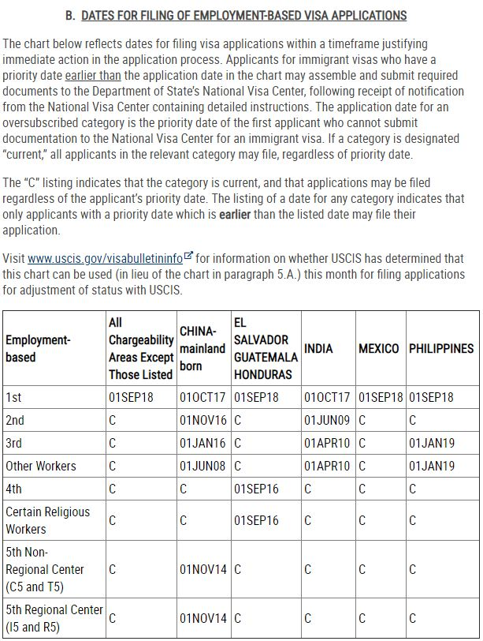
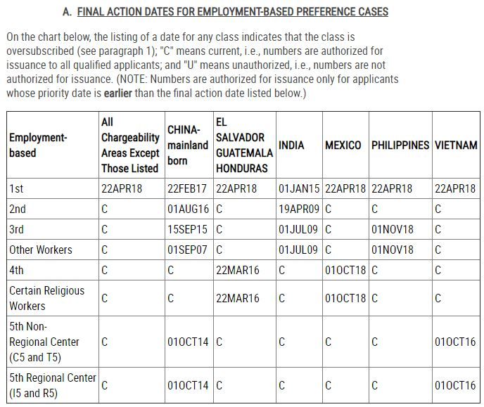
Final Action Date
Filing Date
June 2019 Visa Bulletin
Notes:
If you have a client from Mexico with a SIJS order from Family Court, can you file a green card application for her now?

Slide 29
https://travel.state.gov/content/travel/en/legal/visa-law0/visa-bulletin.html
Notes:
If you have a client from Mexico with a SIJS order from Family Court, can you file a green card application for her now?

Slide 30
USCIS – Which chart should you use?
https://www.uscis.gov/visabulletininfo

Slide 31
Get the monthly visa bulletin by e-mail

Slide 32
Forms included:
Filed Concurrently (affirmative and current)
Two-Step Filing
(defensive or retrogressed)
Step 1
G-28
G-1145
I-360
I-485
I-765
I-912
I-693 (sealed) – can wait for RFE
G-28
G-1145
I-360
Step 2
G-28
G-1145
I-485
I-765
I-912
I-693 (sealed) – can wait for RFE

Slide 33
Supporting Documents
I-360 Petition for Special Immigrant Juvenile Status
Birth Certificate with Certified Translation, if applicable
Special Findings Order
Family Court Order - Guardianship/Custody/ACS Affidavit, etc.
I-485 Application to Adjust Status & I-765 Application for Work Authorization
4 passport photos (2in x 2in)
Copy of passport or other government issued ID
Birth Certificate with Certified Translation, if applicable
Criminal Dispositions, if applicable
Order Terminating Proceedings, if applicable
I-360 Receipt/Approval,if Two-Step Filing

Slide 34
What’s the timeline of a case with a current priority date?
Months 1-6
File SIJS petition & green card app
Months 6-12
Service request on SIJS petition
Years 1 -2
USCIS requests medical exam & any additional info or documents
Biometrics appt
Employment auth. & SSN issues
Decision on SIJS petition
Green card issued

Slide 35
What’s the timeline of a case with a backlogged (“retrogressed”) priority date?
Months 1-12
File SIJS petition
Months 12-48
File green card app
Years 2-4
USCIS requests medical exam & any additional info or documents
Green card issued
Service request on SIJS petition
Decision on SIJS petition
Biometrics appt
Work auth. & SSN issued

Slide 36
USCIS Interview
In most SIJS cases, USCIS waives interviews and adjudicates based on the documents in the file.
RFE for missing documentation or medical exams
USCIS interviews more likely where there is an inconsistency in the file (i.e. previous contact with immigration, CBP, or DOS) or criminal history. USCIS officer will review information on form I-360 and I-485.
Bring all originals of documents previously submitted

Slide 37
After approval
Young person becomes a Lawful Permanent Resident immediately
Eligible for federal financial aid and limited benefits
Can apply to become naturalized US Citizen after 5 years/ once child turns 18 years old (whichever comes later)
Subject to same deportation grounds as other green card holders (criminal charges + long trips abroad most common)
Counsel young person about benefits/obligations as LPR

Slide 38
Bar on Benefits for parents
SIJS grantees will not be able to assist their biological or prior adoptive parents obtain an immigration benefit at any future point.
Applies to even the non–abusive/ abandoning/ neglectful parent
Does not directly affect a biological or prior adoptive parent’s ability to adjust status through any other method.
“no natural parent or prior adoptive parent of any alien provided special immigrant juvenile status…shall thereafter, by virtue of such parentage, be accorded any right, privilege, or status under this Act.”
8 USC 1101(a)(27)(j)(iii)(ii)

Slide 39
Common Eligibility Issues

Slide 40
Admissibility for Adjustment
Some inadmissibility grounds automatically waived for SIJS applicants:
Public charge
Work without authorization
Improper entry or visa overstay
Material misrep.
Unlawful presence

Slide 41
Which inadmissibility grounds are NOT automatically waived?
Health Grounds
Communicable diseases of “public heath significance”
Missing required vaccinations
Criminal Grounds
Controlled substances
Juvenile adjudications & adjournments in contemplations of dismissal are not convictions
“Disorders” that pose a threat to public safety
“Drug abusers”
Waivers available
Firearms offenses
Waiver for possession of marijuana < 30g

Slide 42
Common Hurdles with USCIS
Inconsistencies in prior contact
Statements at border, consular interviews, prior applications
Tip: Submit FOIA for previous interactions
Sufficiency of SIJS Order
RFEs/NOIDs for proof of state law basis in SIJS Orders
Family Court rules protect privacy of records
Pushback on “primary purpose”
RFEs/NOIDS angled at primary purpose for family court proceeding
Not a viable line of inquiry for USCIS, seek guidance for RFE response

Slide 43
Pandemic-era advocacy
Difficulties in client contact and relationship building
Family court closures and subsequent backlogs
USCIS biometrics issues and delays
Immigration court closures and uncertainty
Illness and family instability

Slide 44
Thank you!
Materials developed by Volunteers of Legal Service in collaboration with the following providers:
The Door’s Legal Services Center, The Urban Justice Center’s Peter Cicchino Youth Project, the New York Immigration Coalition
Questions? Please contact Emma Morgenstern, VOLS Immigration Project Staff Attorney at emorgenstern@volsprobono.org or 347-521-5726

Slide 45
40 Worth Street, Suite 820
New York, New York 10013
www.volsprobono.org

